Slide 1

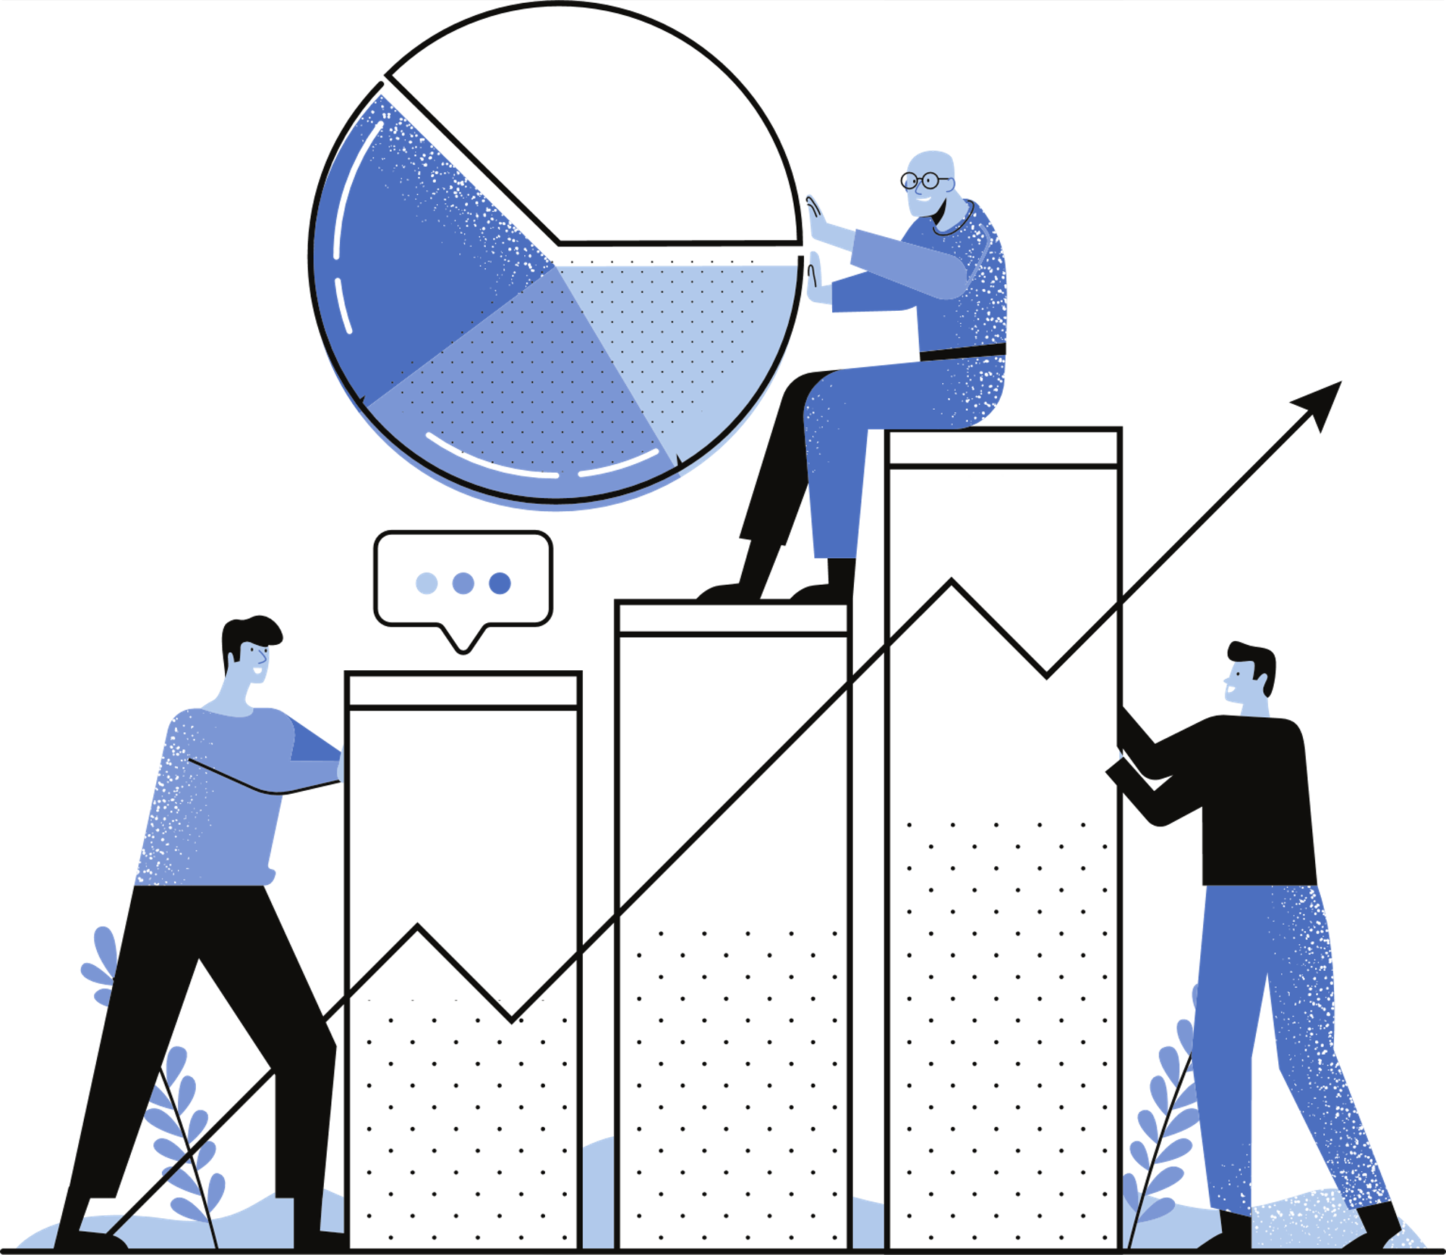
Group 5:
__doc__()
aka: the second pecha kucha.

Slide 2

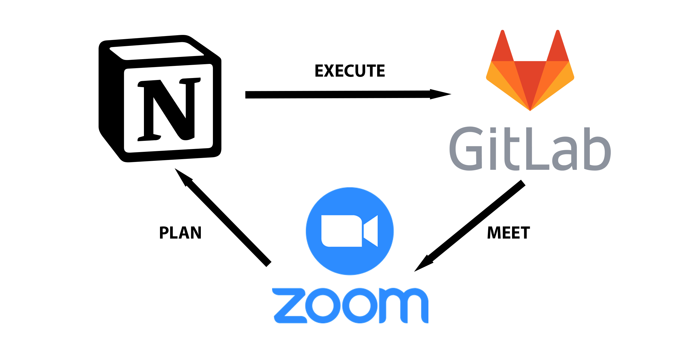

Workflow

Slide 3




ML: Introduction
Extraction
Formatting
Car Detector
Damage Classification

Slide 4



ML: Data pipeline
8100 Without bbox
Without Car
50k Images
900 With bbox
With Car
Manual classification
9k Defect
Notes:
Numbers in the middle represent how much working data is left in that step

Slide 5
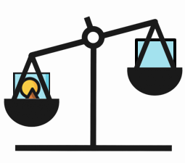
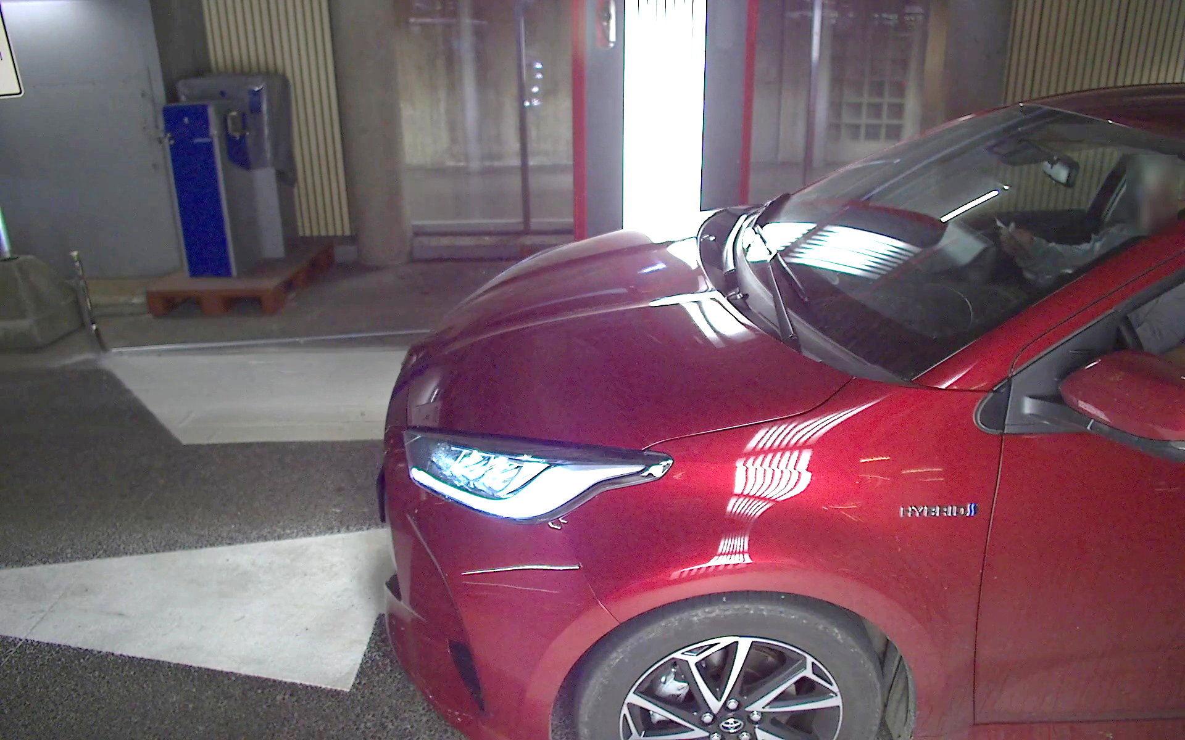
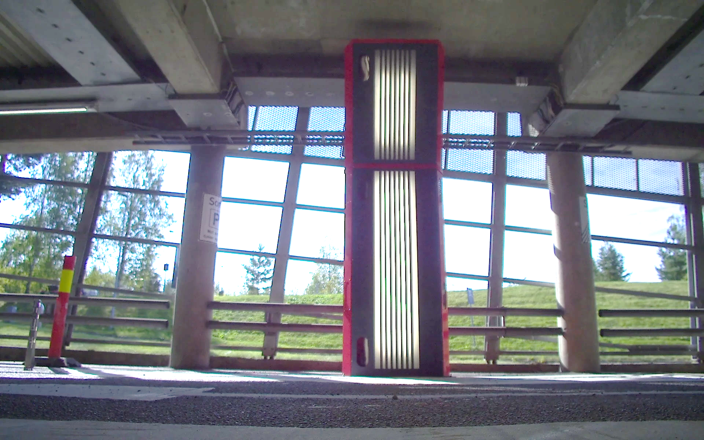
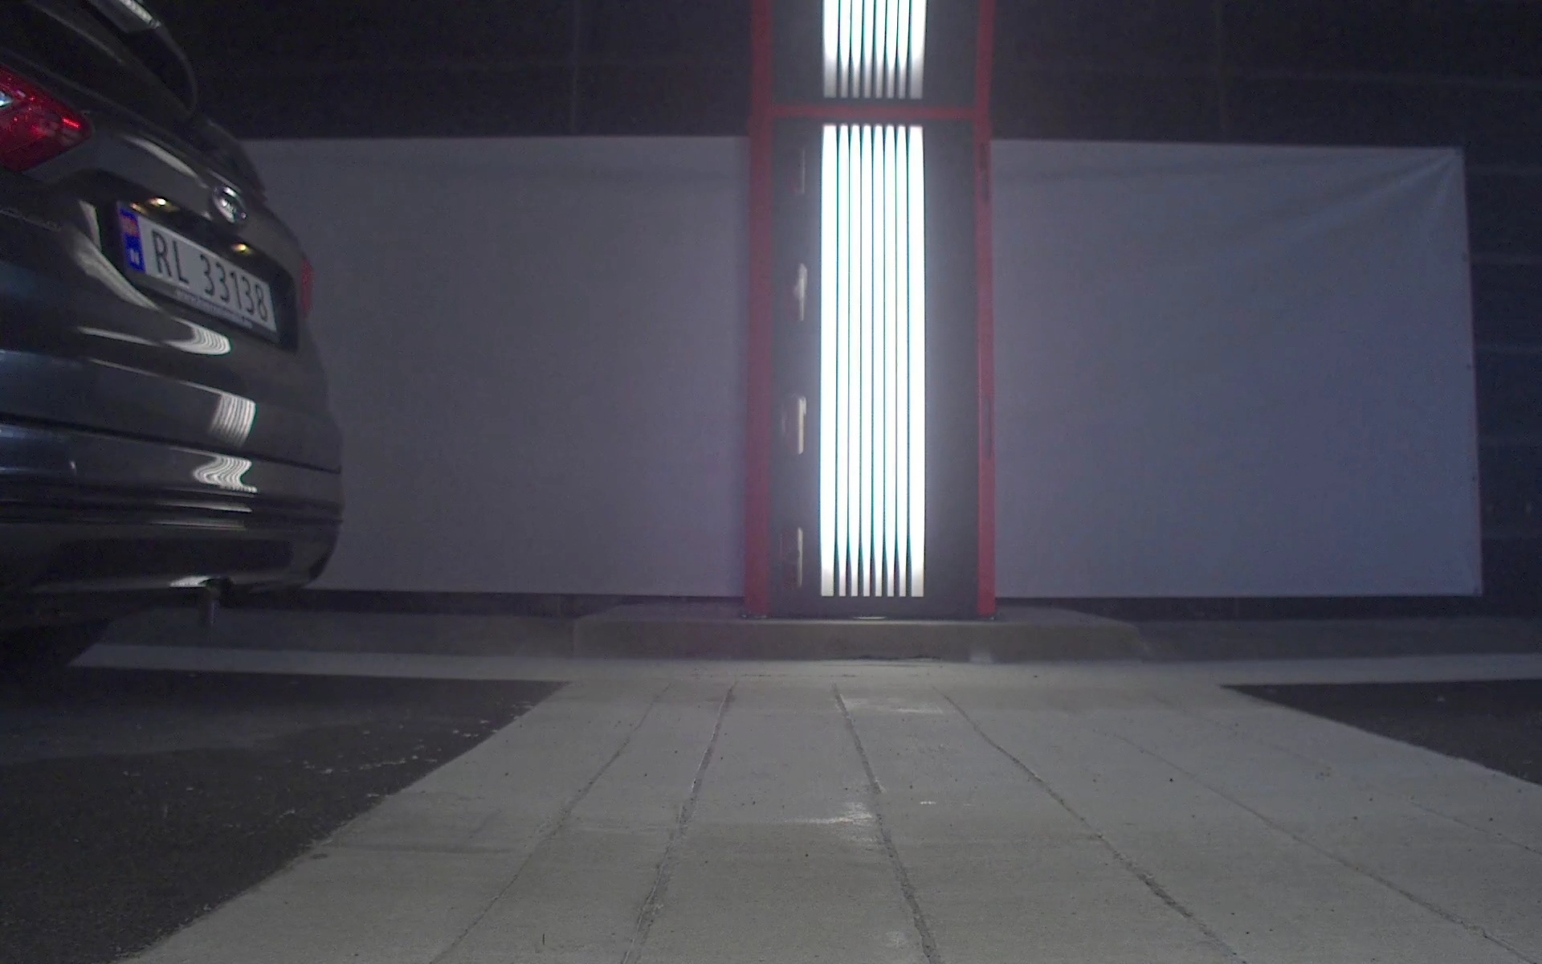
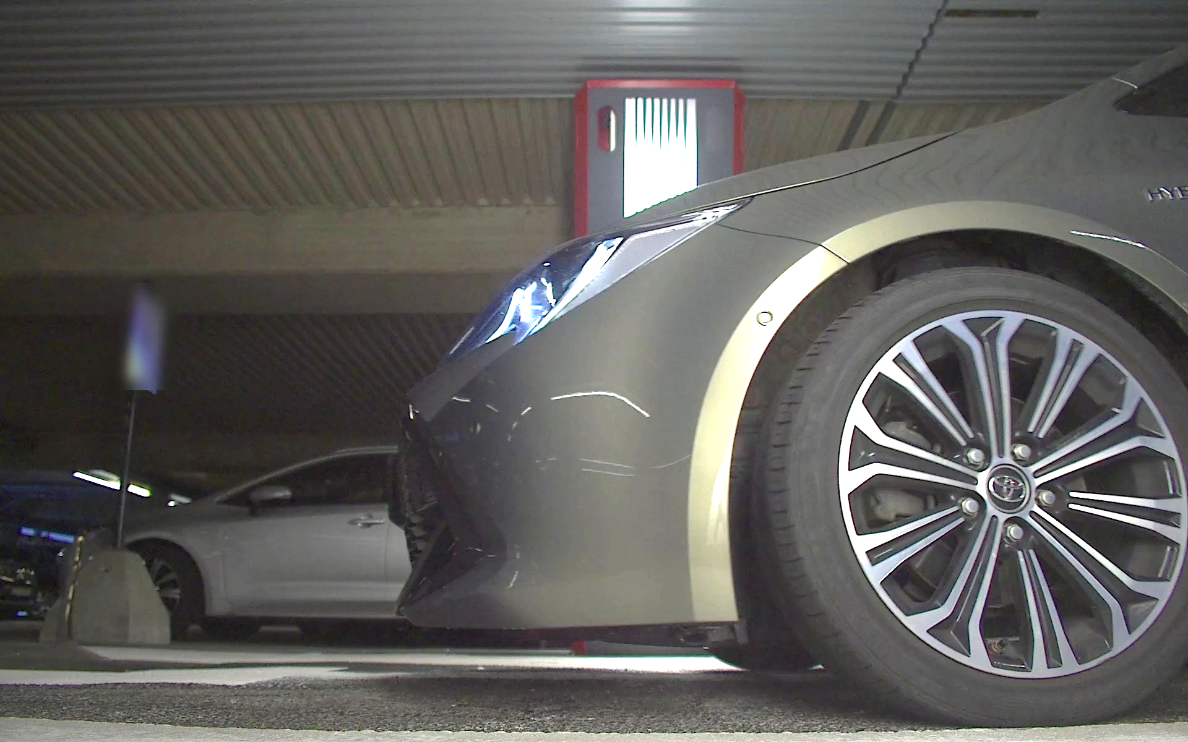
Car Detector Model:
Why?

Slide 6
Car Detector Model: Parameters
Learning Rate
1e-4
Batch-size
32
Epochs
20
Models used
VGG16, ResNet50
Metrics
Accuracy, F1-score, Precision
Loss function
Binary_Crossentropy

Slide 7
Car Detector Model: Class distribution

Slide 8
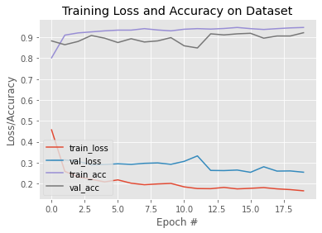
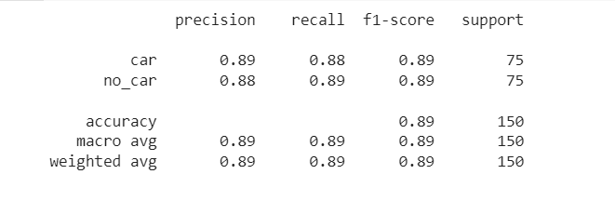
Car Detector Model: Results (ResNet50)
Classification_report_resnet

Slide 9
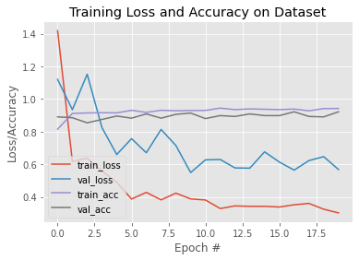
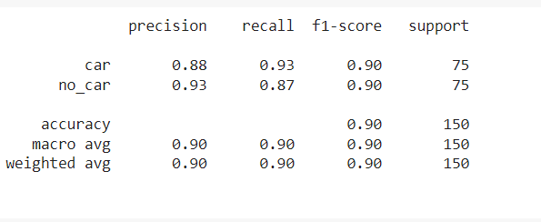
Car Detector Model: Results (VGG16)
Results with vgg16 – sticking with this
Classification_report_vgg

Slide 10

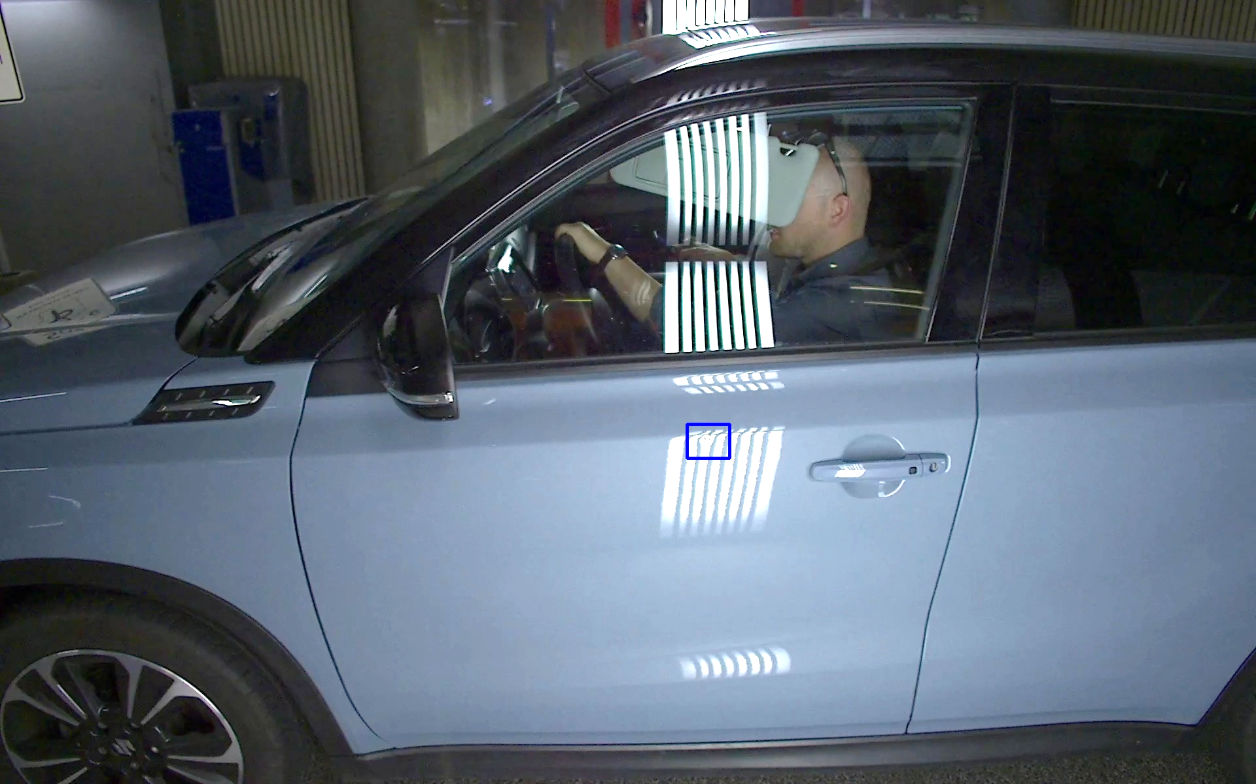
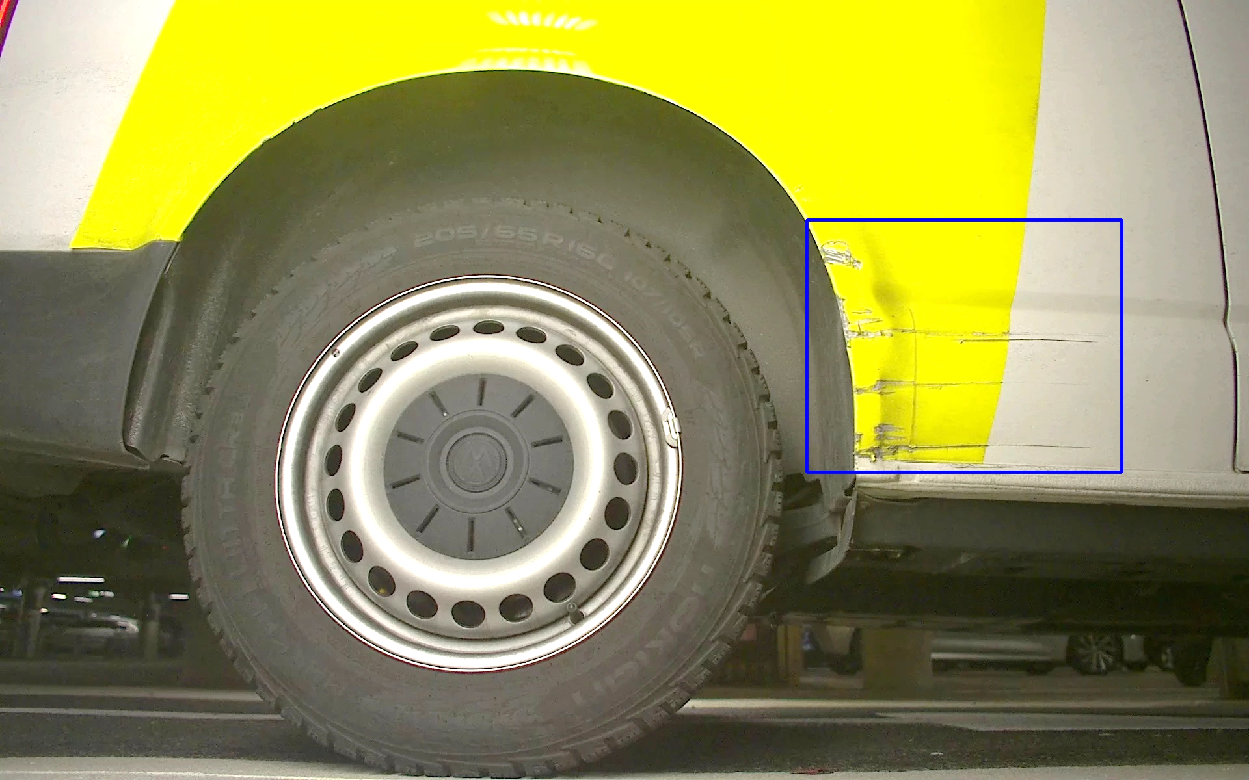




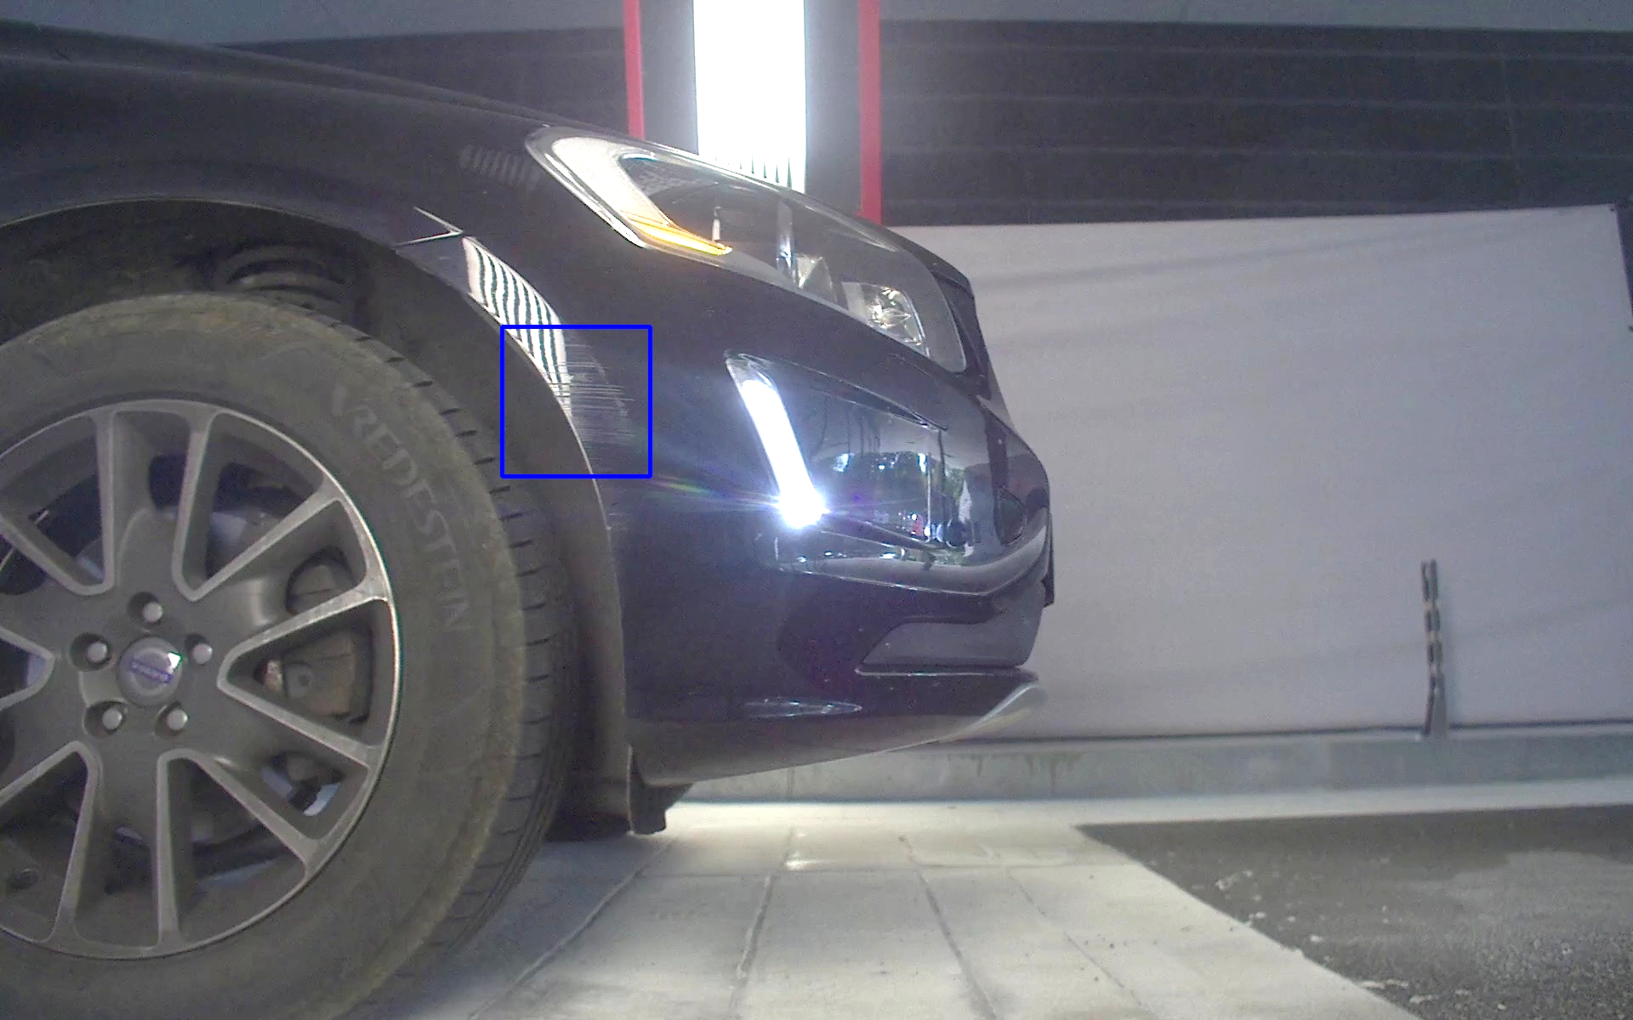
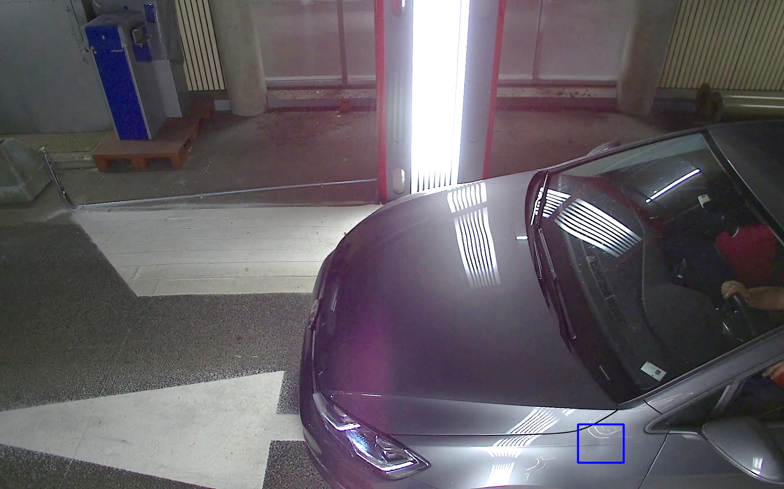
ML: Extraction & Segmentation
Manual classification by team
Train final model.
Notes:
[no]car model gives us car-only images. The images are bboxed and split among team members for manual labelling. The labelled images will be used for final model training.

Slide 11


ML: To be done
Split data between team members
Manual damage classification
Train final model
Research various approaches
Notes:
What Tool to make classification easy.
Refer to intro slide for where 8100 images comes from.
Literature review can give us new ideas but will not affect our already done [no]car model.
on this slide, stress on literature review because other parts have already been touched on

Slide 12
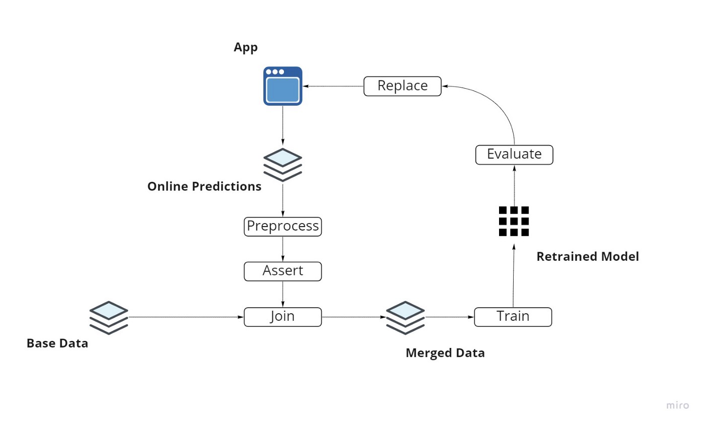
ML:
Retraining of model
Notes:
What Tool to make classification easy.
Refer to intro slide for where 8100 images comes from.
Literature review can give us new ideas but will not affect our already done [no]car model.
on this slide, stress on literature review because other parts have already been touched on

Slide 13



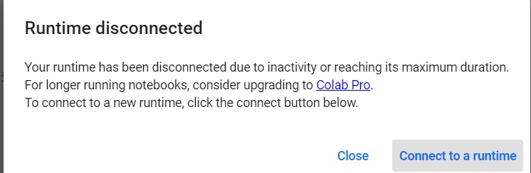
ML: Tools
Notes:
Mention why colab: free tier and really good resources AS WE AWAIT the chair‘s resource provisioning (but don‘t be mean about it lol)
Keras and TF because Google.
Colab access is limited. Could really use a premium subscription from the chair, or that virtual machine promised. (smile here)

Slide 14

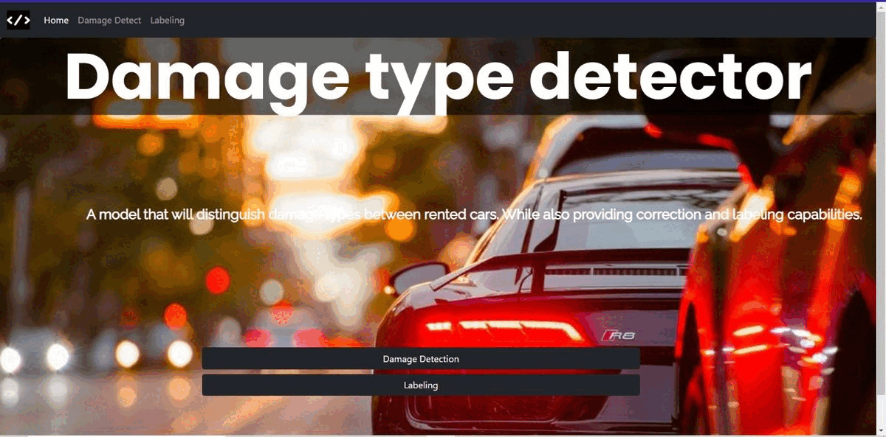
WebDev: Progress so far
WebDev: Progress so far

Slide 15
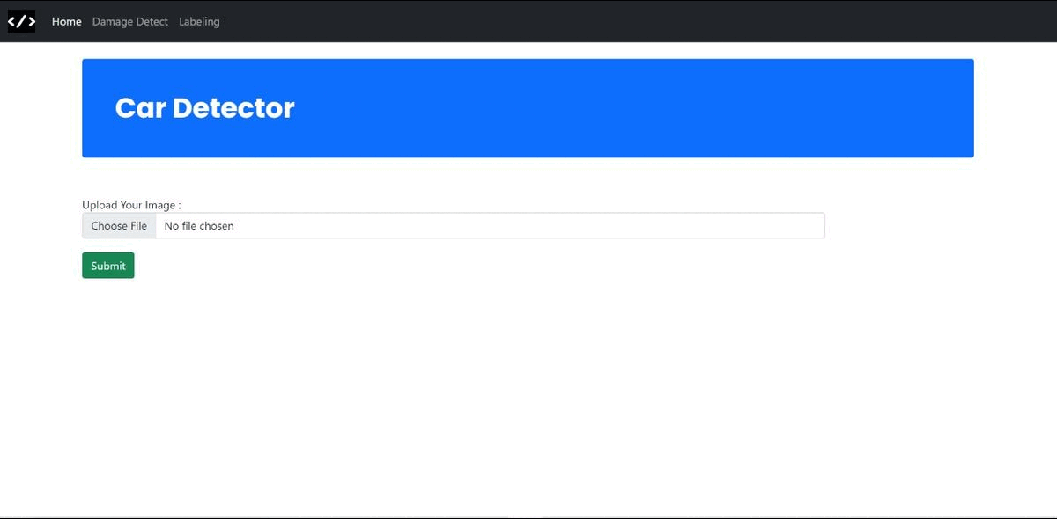
WebDev: Progress so far
WebDev: Progress so far

Slide 16






Tools
Front-End
Back-End

Slide 17
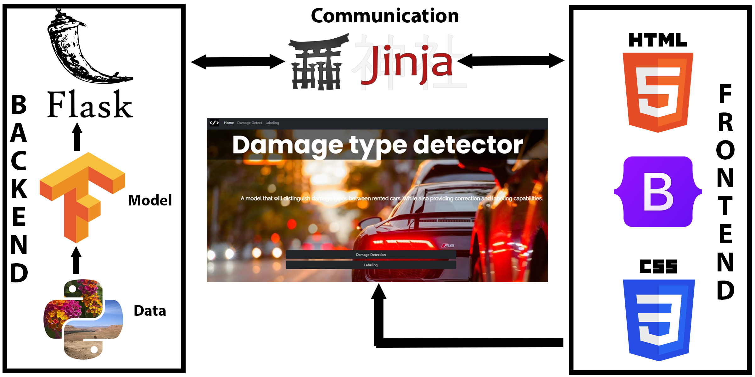
WebDev: How everything works
How everything works

Slide 18
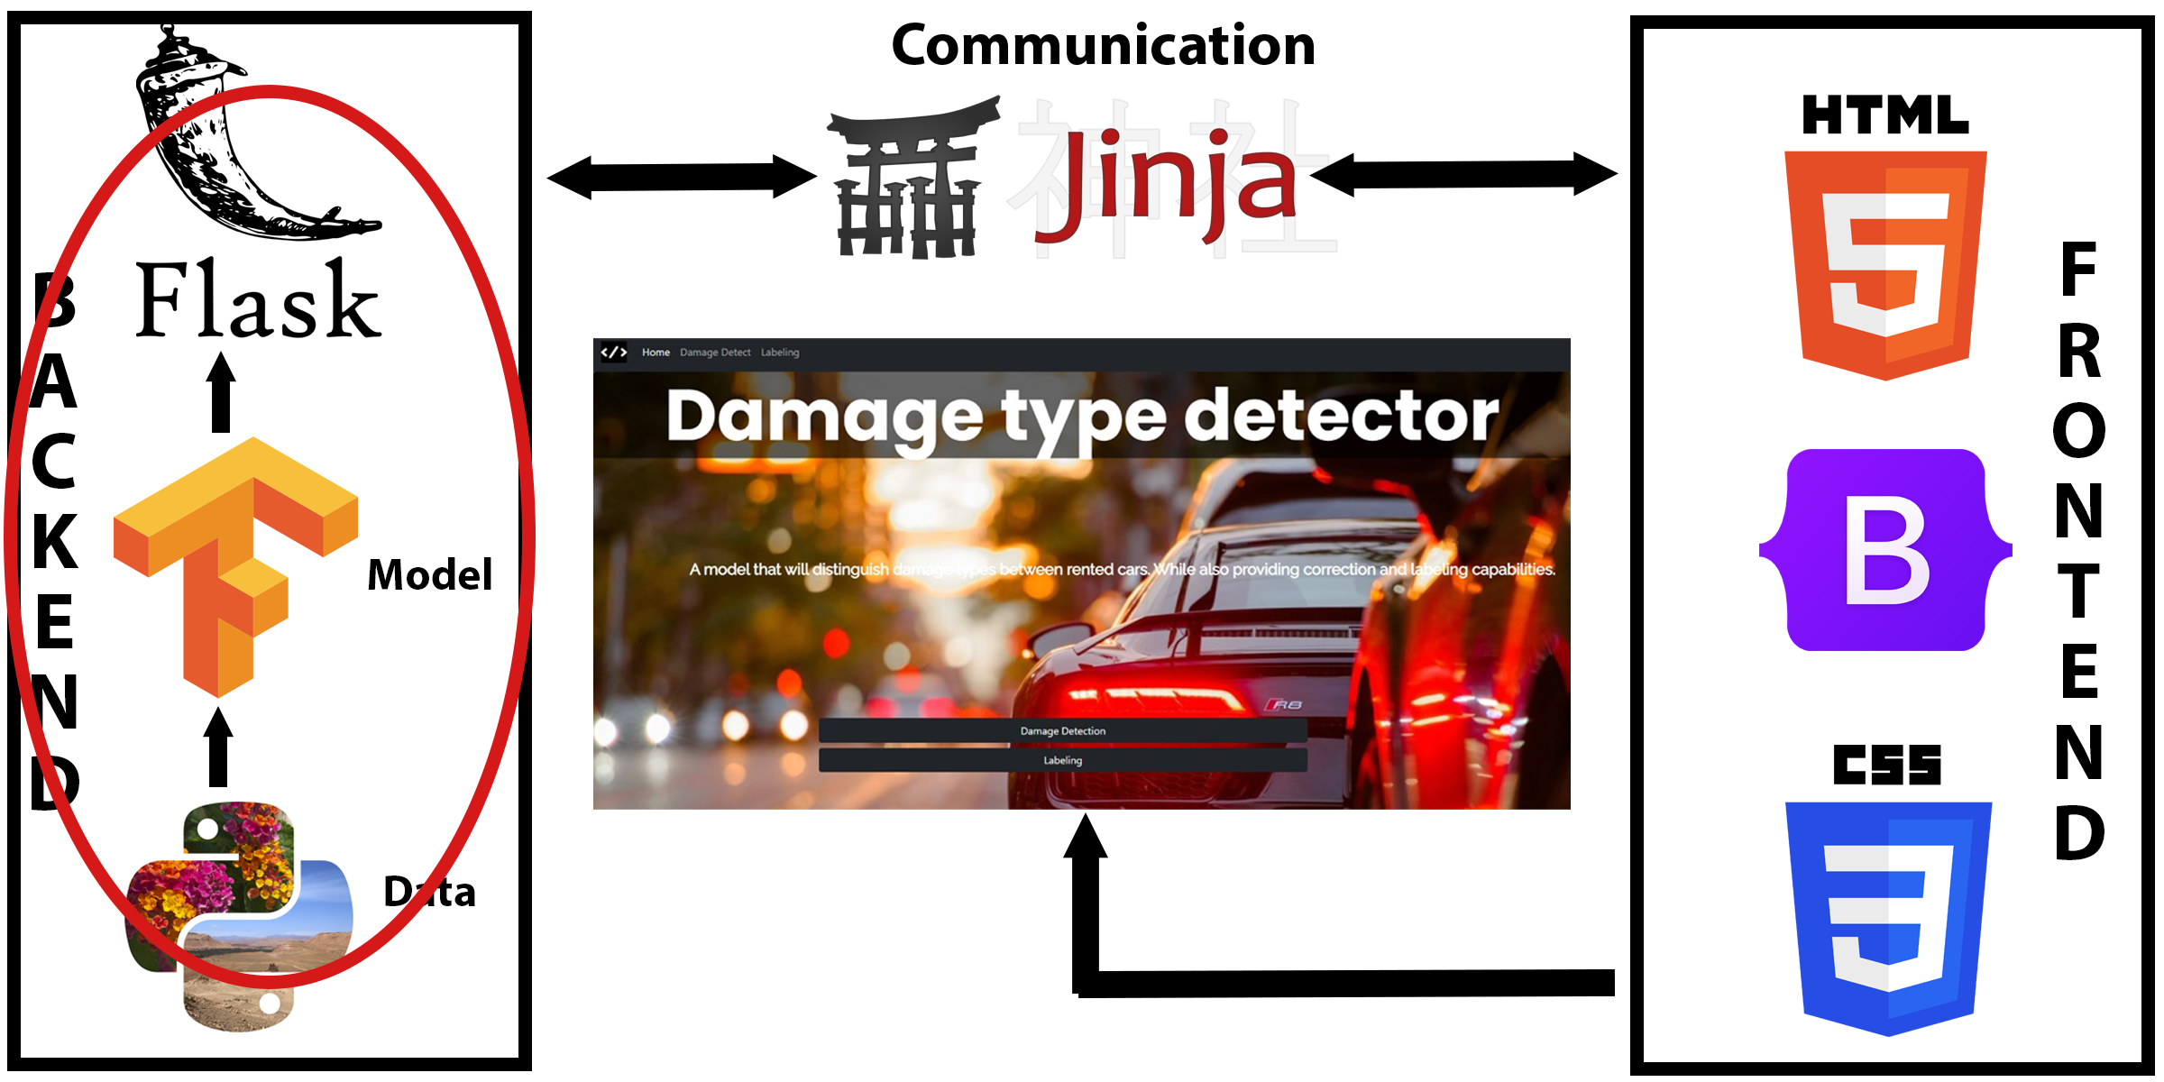
WebDev: Difficulties
How everything works

Slide 19
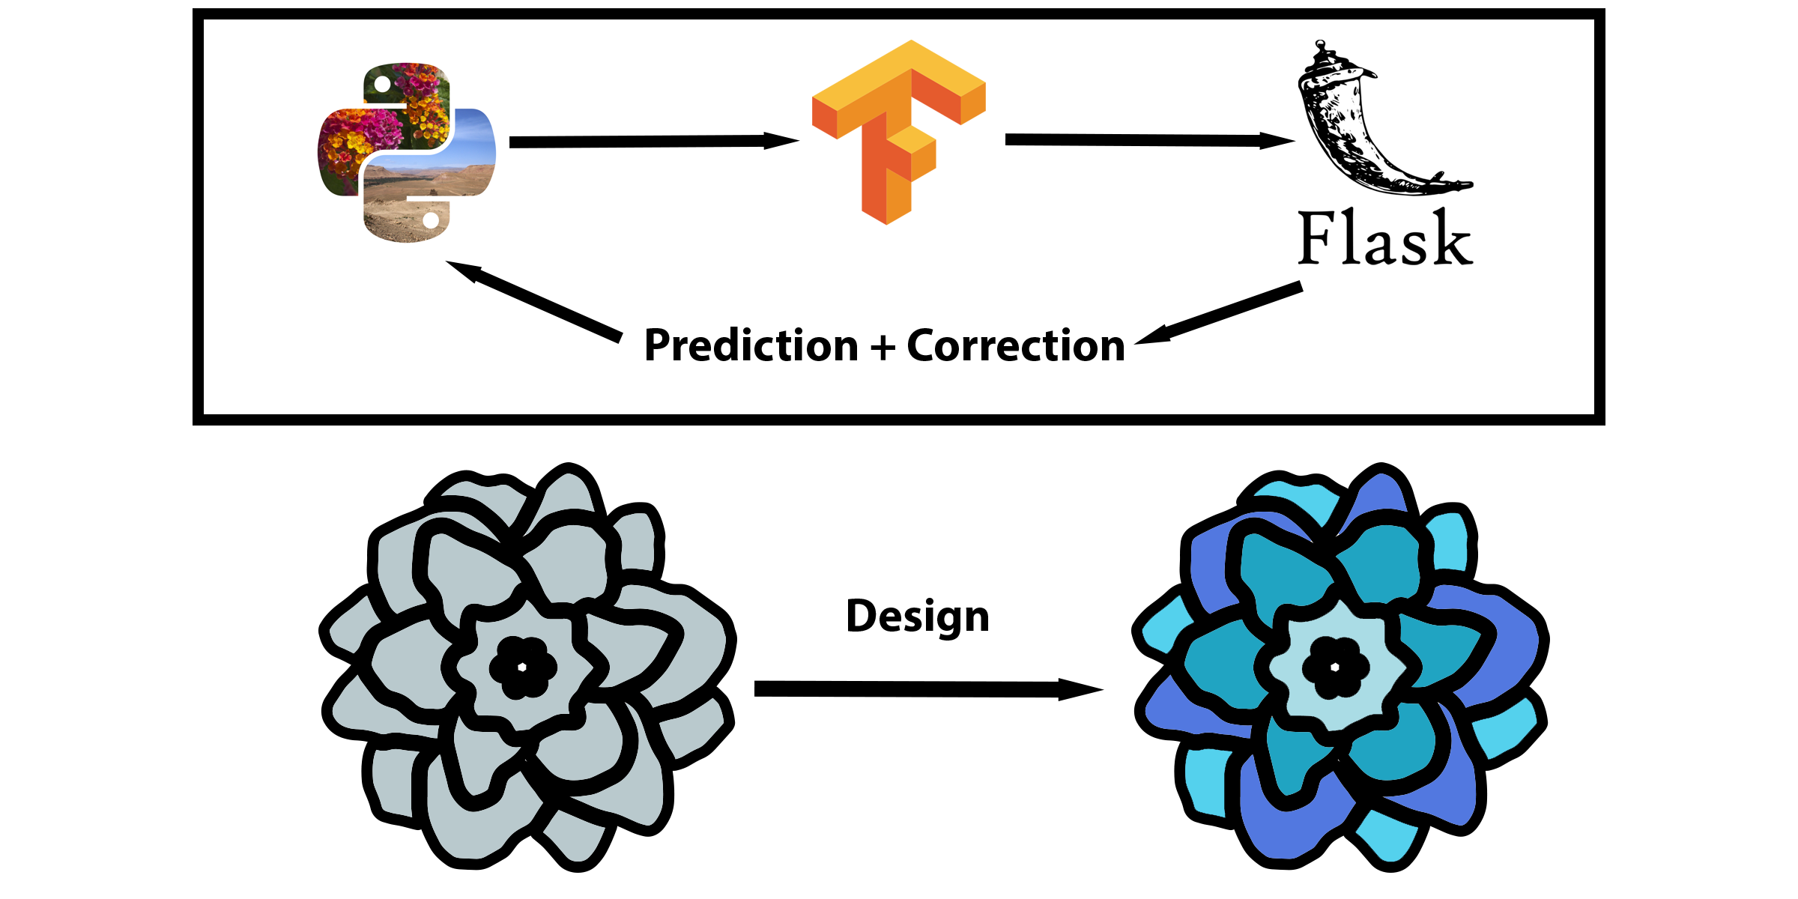
Next steps
WebDev: Next steps

Slide 20

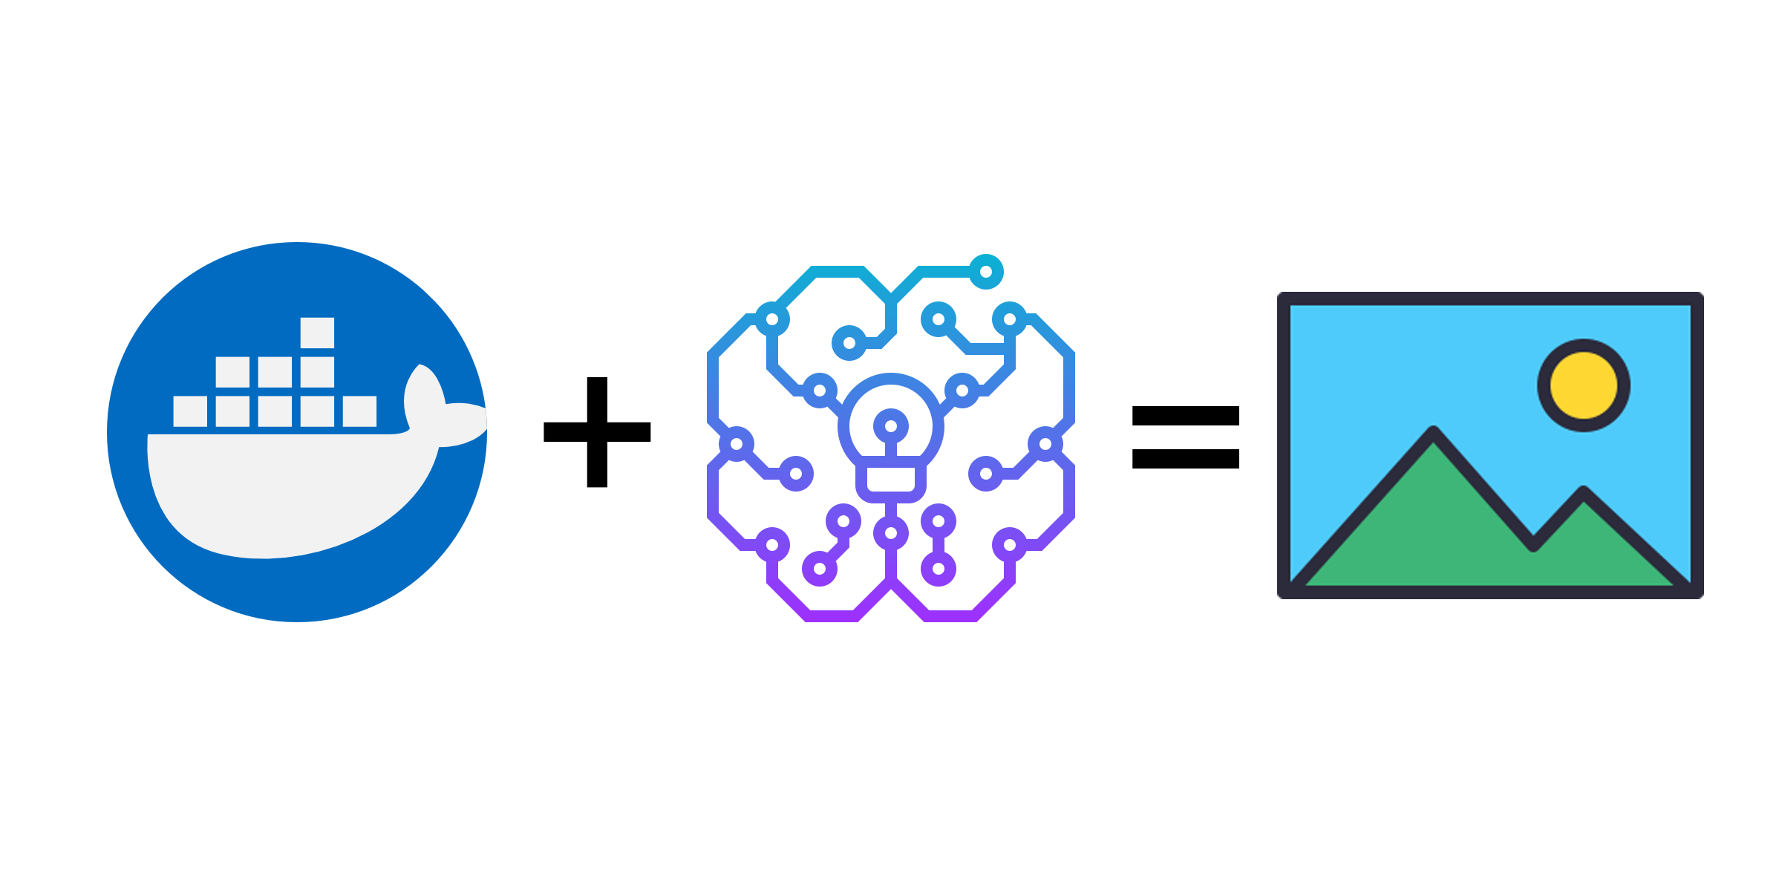
Current state
Deployment: Progress so far

Slide 21



Sprint 1 - Review
Week 1 - 3​
.
ML Team: Model development​.
Deployment Team: Learning Docker​.
Web team: Barebones web framework​.
Media Team: Pecha Kucha 2

